Slide 1

Microservice vs Monolithic Architecture

Slide 2
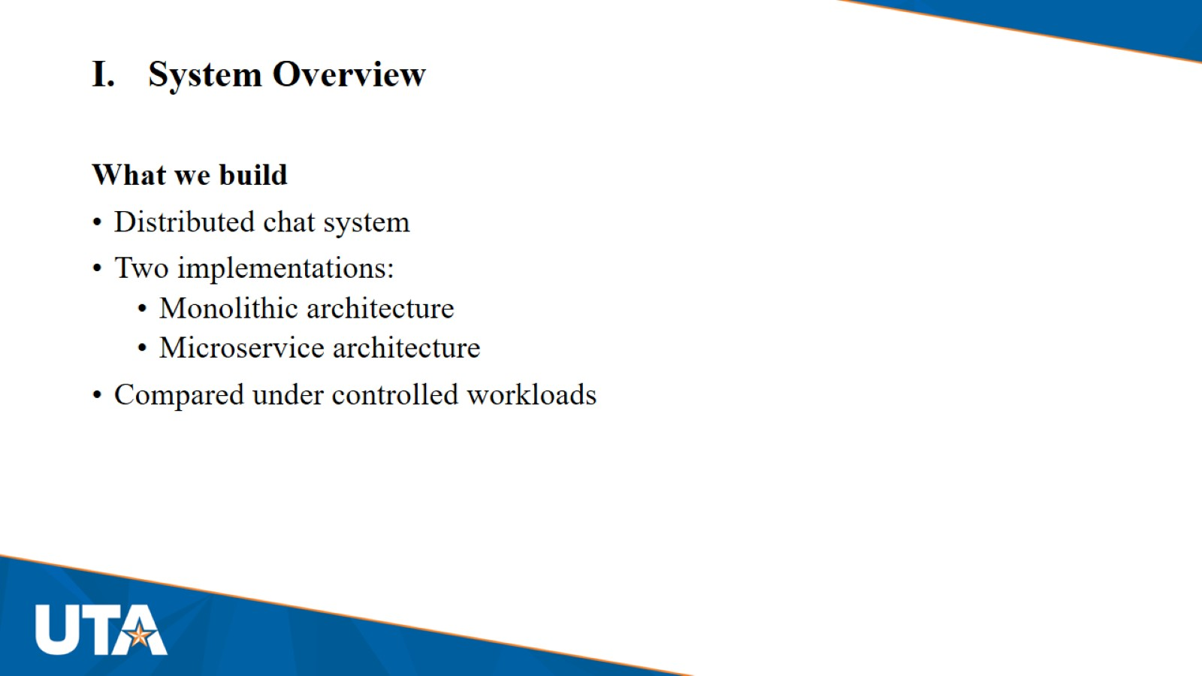
System Overview

Slide 3
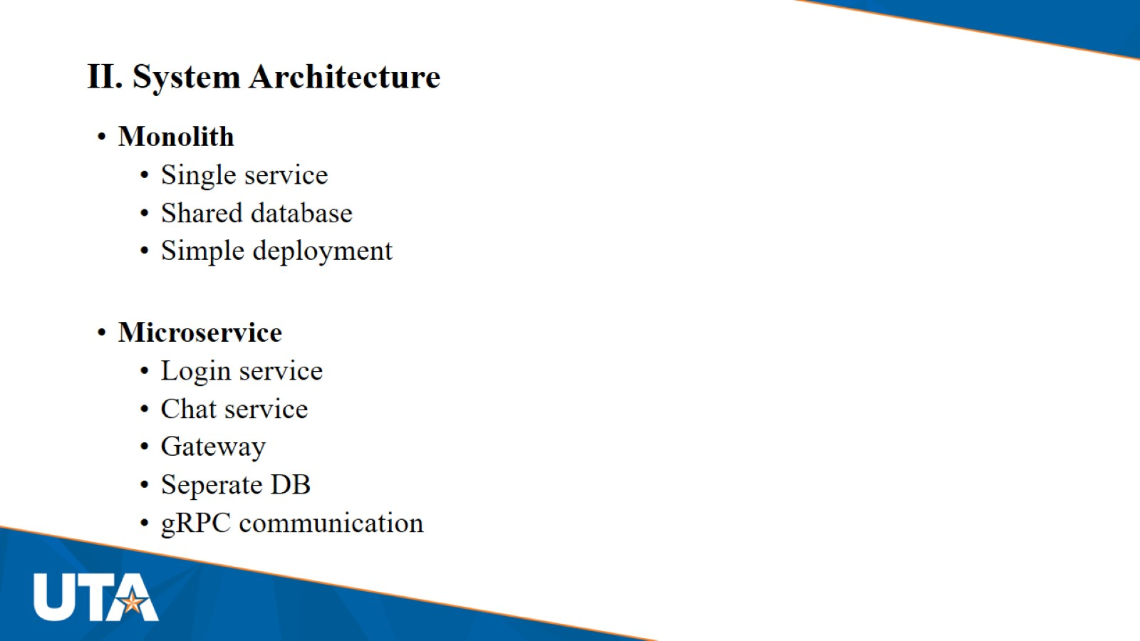
II. System Architecture

Slide 4
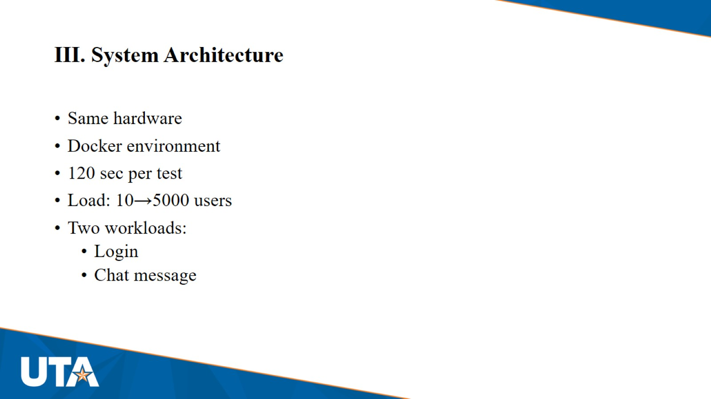
III. System Architecture

Slide 5
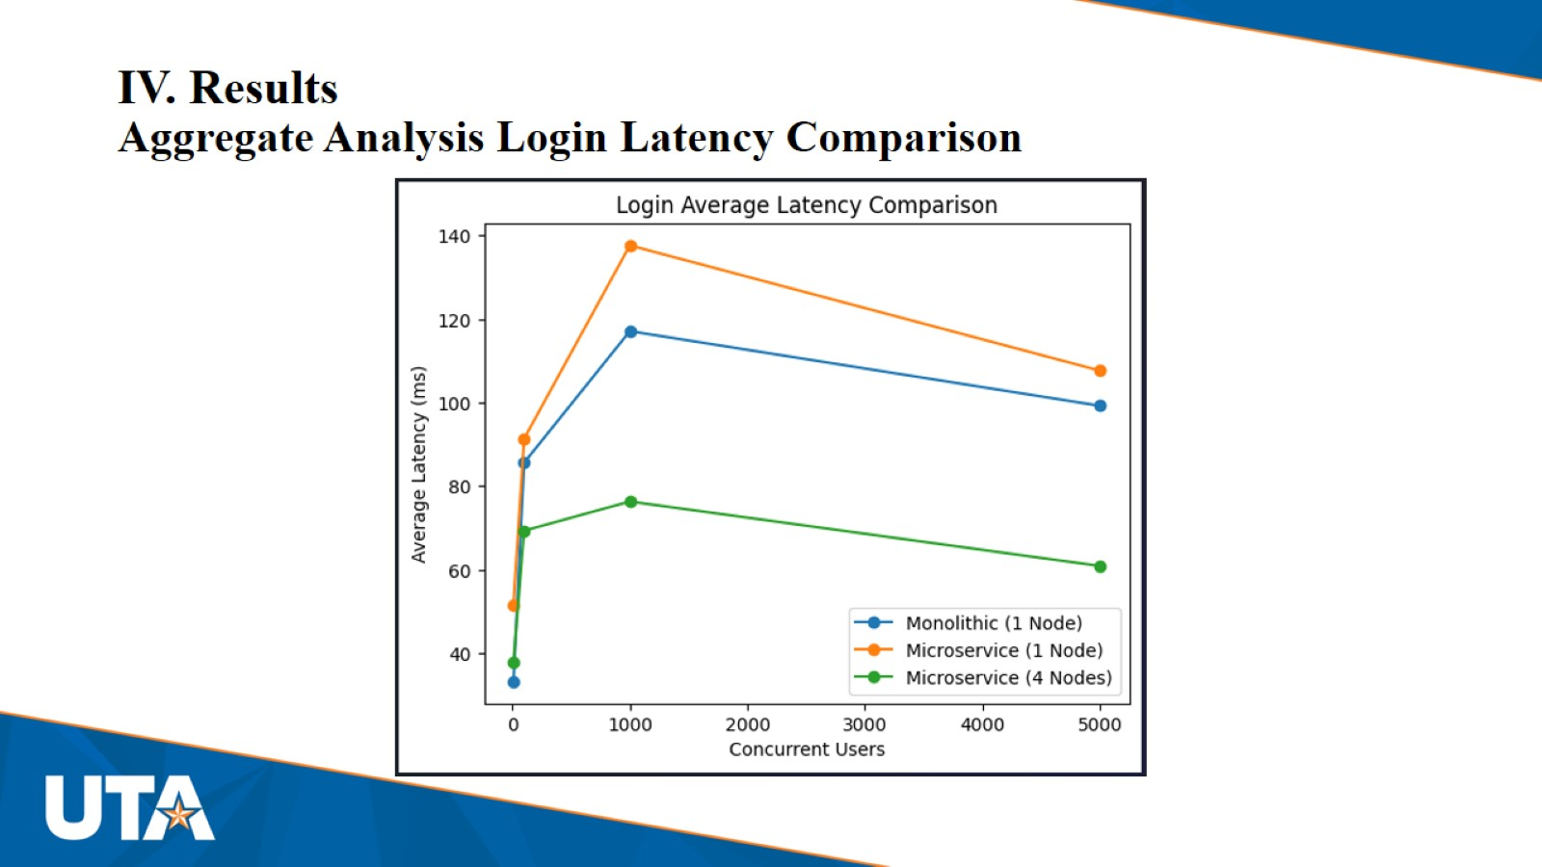
IV. Results
Aggregate Analysis Login Latency Comparison

Slide 6
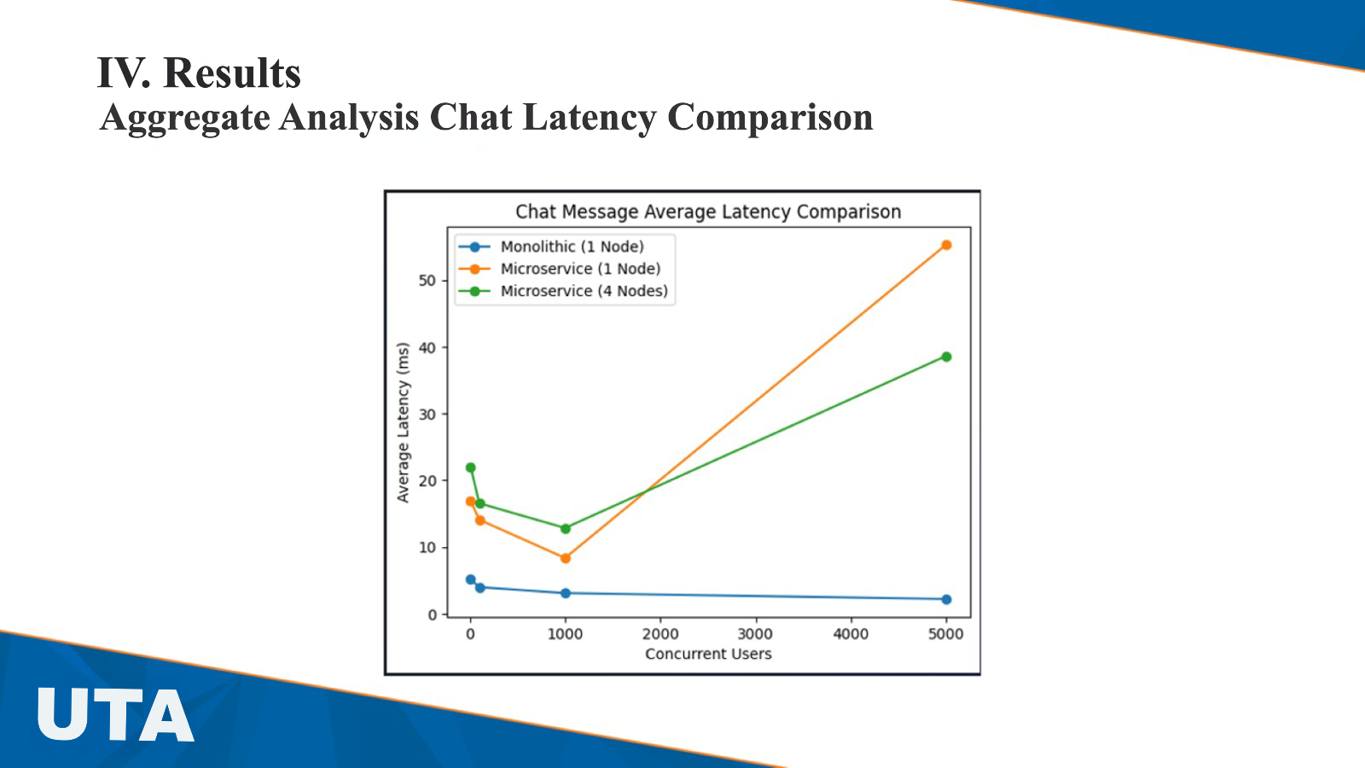
IV. Results
Aggregate Analysis Login Latency Comparison

Slide 7
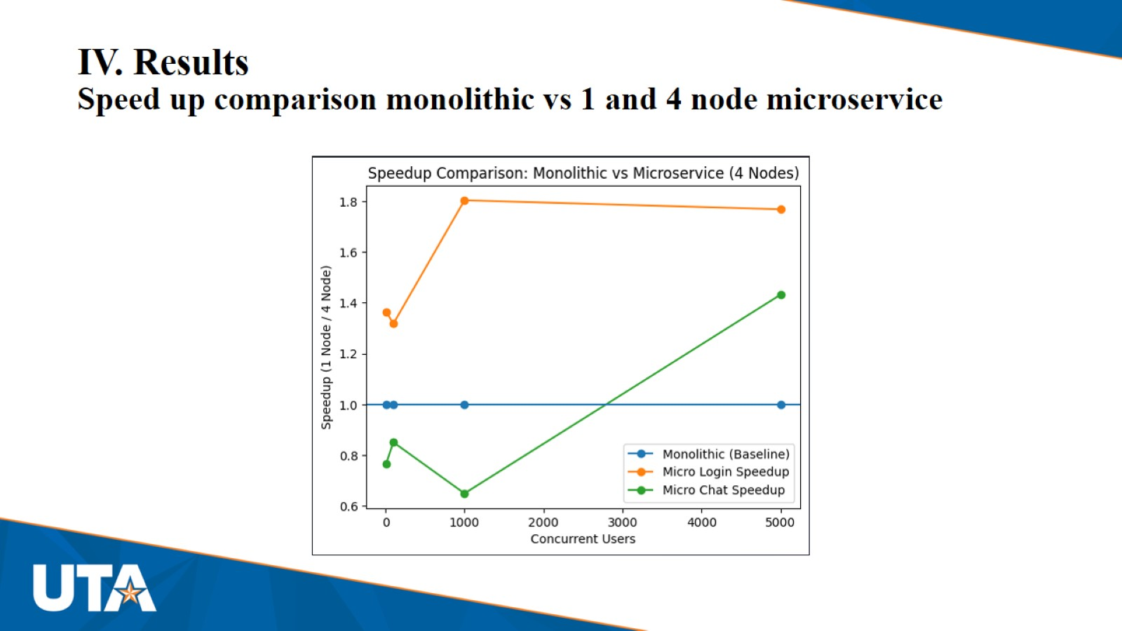
IV. Results
Speed up comparison monolithic vs 1 and 4 node microservice

Slide 8
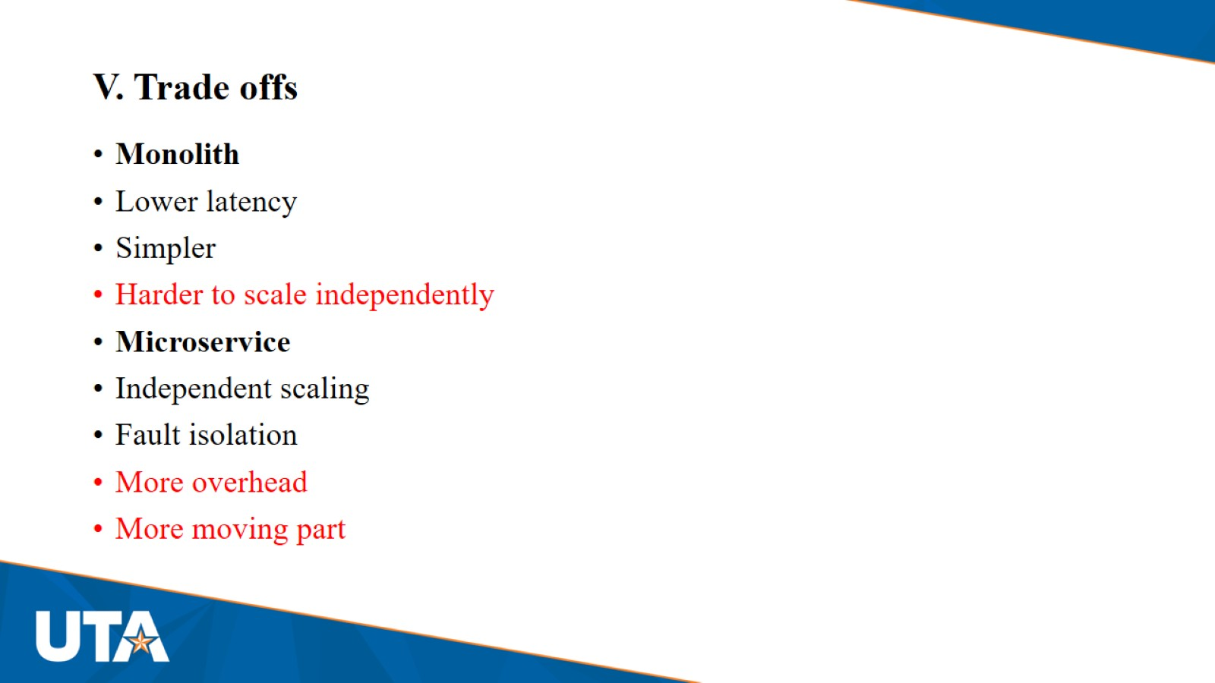
V. Trade offs

Slide 9
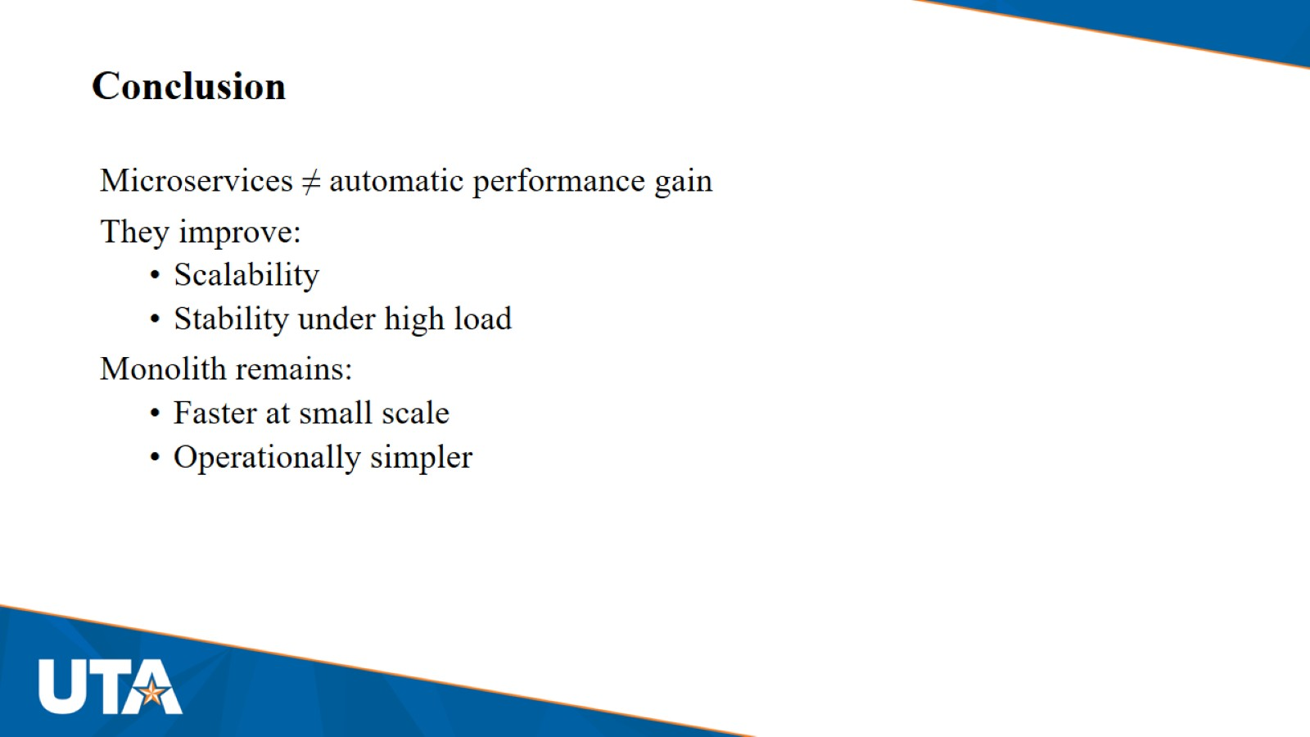
Conclusion

